Slide 1
Follow-up Visit Procedures
MTN-027 Study Specific Training

Slide 2
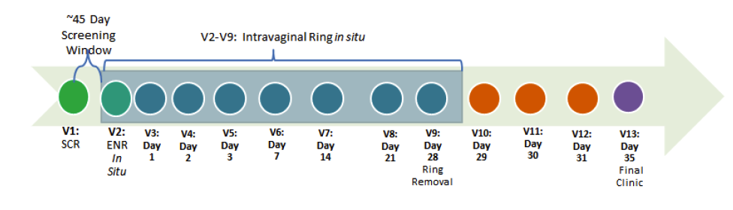
Study Visit Schedule
Notes:
There are a total of 11 scheduled follow-up visits:
Visits 3-8 (Days 1, 2, 3, 7, 14, 21)
Visit 9 (Day 28)
Visits 10-12 (Days 29, 30, 31)
Visit 13 (Day 35)

Slide 3
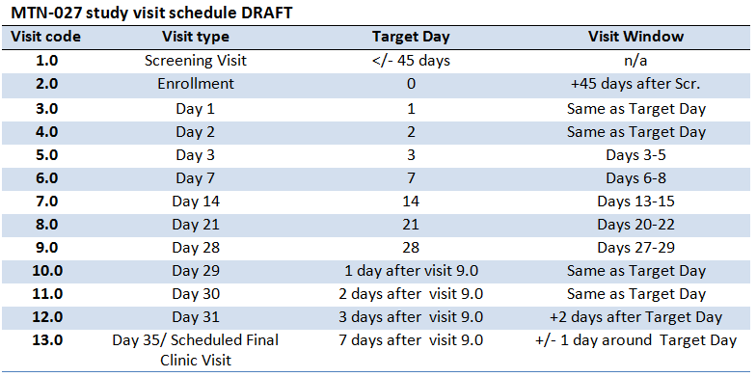
Target Visit Dates and Visit Windows
Notes:
Sites are encouraged to complete required study visits on the target day if at all possible. If this is not possible, the visit may be completed within the visit window (for visits with a window). Visits completed within the visit window will be considered completed ("retained") visits.
For Days 3, 7, 14, 21, 28, 31, and 35, there are visit windows specifying on which study days the visit can be completed.
All other visits do not have visit windows as they are completed on consecutive calendar days. Although the visit windows allow for some flexibility, the intent of the protocol-specified visit schedule is to conduct follow-up visits at specific intervals, and every effort should be made to do so.
Given the intense visit schedule, enrollments should ideally occur on Monday or Tuesday to avoid (as much as possible) having follow up visits on a weekend.
Visit windows were set to allow some flexibility in participant's schedules, but that the main driver in scheduling these visits is ensuring PK specimen collection within very specific timepoint (+24, 48 hours post ring insertion, +24, 28, 72 hours post ring removal. Just a thought to provide the rationale behind this.

Slide 4
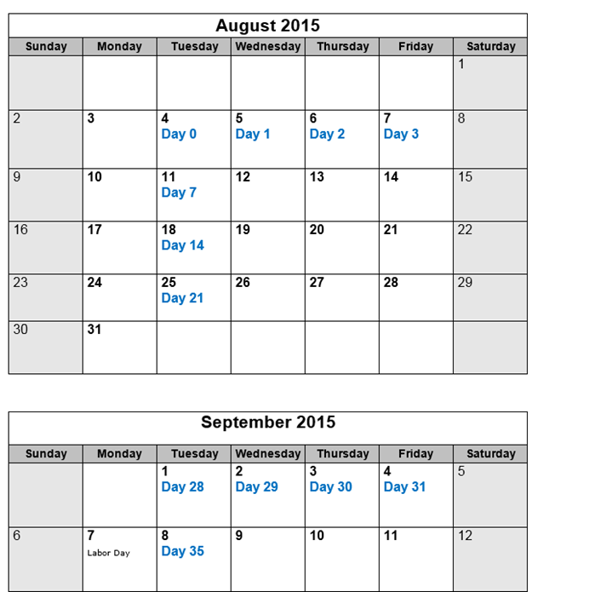
Follow-up Clinic Visits
For example, if a participant is enrolled on August 4, 2015, her clinic visits will be as follows:
Notes:
To avoid visits over the weekend, enrollments must take place either on a Monday or Tuesday. When enrolling participants, it is also important to keep in mind Day 28 visit. Discuss with participants the importance of this visit and to closely consider her itinerary to ensure this visit is not missed and it takes place exactly at Day 28.

Slide 5
Procedures completed at all scheduled clinic follow-up visits
Administrative/
Regulatory
Locator Information
Reimbursement
Protocol Requirements counseling*
Update/Record AE
Schedule/verify next visit*
Clinical
Medical and Menstrual History
ConMeds
Physical and Pelvic examination
Provide test results
Lab
PK Blood
PK Vaginal Fluid
Behavioral
*if indicated
Notes:
At day 35 although per protocol scheduling next visit/contact is done if indicated, it is recommended to discuss with participant contact to provide test results.
Although protocol requirement counseling is done per protocol if indicated, components of the counseling should be reviewed at all visits and tailored to participants’ needs.
NOTE: At all visits, with the exception of Day 28, these are single time-point PK collections. At Day 28, collection will be done at hours 0,1,2,4,6.

Slide 6
Procedures Specific to
Visits 3-8 (Days 1, 2, 3, 7, 14, 21)
Behavioral
Follow-up CASI questionnaire at Days 7, 14, 21
Laboratory
pH, Gram stain, quantitative vaginal culture, vaginal biomarkers at Day 3
hCG at Day 14
Notes:
In addition to procedures that are required at all visits, the following procedures are also required at these visits.

Slide 7
Procedures Specific to Visit 9 (Day 28)
Laboratory
hCG
CBC with diff/platelets
Dipstick UA
Chemistries
Blood PK at hours 0,1,2,4,6
Cervical Tissue for PK (and PD at Pitt only)
pH, Gram stain, cytobrush, quantitative vaginal culture, vaginal biomarkers
Vaginal PK at hours 0,1,2,4,6
Rectal Fluid for PK (optional)
Study Product
Behavioral
Collect IVR
Follow-up CASI

Slide 8
Procedures Specific to Visits 10-12 (Days 29, 30, 31)
What additional procedures are required at Visits 10-12?

Slide 9
Procedures Specific to Visits 10-12 (Days 29, 30, 31)
What additional procedures are required at Visits 10-12?
  Besides the procedures required at every follow-up visit, no additional procedures are required at these visits.

Slide 10
Procedures Specific to Visit 13 (Day 35)
Behavioral
HIV pre and post test counseling
Laboratory
HIV testing
CBC/Chemistries
pH, Gram stain, quantitative vaginal culture, vaginal biomarkers
In-depth Interview
Exit CASI

Slide 11
Procedures Done if Indicated
At any visit, the following procedures may be done if indicated:
  Protocol requirements counseling (protocol/product adherence, contraceptive)
  Pregnancy Testing
  HIV testing (and associated counseling)
  STI Testing: syphilis serology, rapid Trichomonas, wet mount for candidiasis and BV, vaginal pH, or Vaginal NAAT GC/CT
  Dipstick UA, Urine culture
  CBC with platelets/differentials and chemistry
  Refer or provide treatment

Slide 12
Adherence Counseling Considerations During Follow-up
During follow-up visits, adherence counseling should be provided if indicated
At a minimum, it is recommended that staff briefly check in with participants at regular intervals (about once per week)
  For example, visit days 7, 14, and 21
If the participant reports ring removals or expulsions, is experiencing discomfort, and/or has any questions or concerns about ring use, address in a neutral and non-judgmental way
Note: Administer Ring Adherence CRF prior to counseling
Notes:
Check in at weekly intervals to see how ring use is going and if they have any questions or concerns.

Slide 13
Adherence Counseling Considerations During Follow-up (Cont.)
Use open-ended questions to discuss experiences:
  For example, “What has your experience with ring use been so far?” or, “How has ring use been going for you?”
Work with participants to develop strategies and goals to either maintain good adherence, or to overcome adherence barriers
When needed, review ring use insertion instructions or key adherence messages
When needed, provide skills building to the participant
  For example, how to discuss ring use with partners or other influential persons

Slide 14
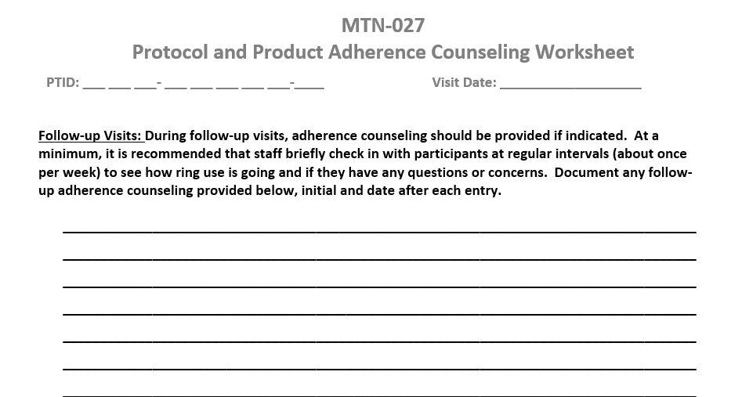
Adherence Counseling Documentation
Adequate time should be taken to counsel the participant and address any questions or concerns the participant may have. Each counseling session should be fully documented per site SOPs for source documentation.

Slide 15
Social Harms
Non-medical adverse consequences that may occur as a result of participation in the study.
  Difficulties in their personal relationships with partners, family members, and friends.
  Stigma or discrimination
Document the issues or problems and make every effort to facilitate their resolution
  Report on Social Impact log CRF.
The IoR will report any social harm, in his/her judgment, to be serious or unexpected to the PSRT and IRB according to local requirements.
  For example, social harms that result in serious adverse events (SAEs) should be considered ‘serious or unexpected’.
  Serious threats of physical harm, significant psychological duress, or discontinued provision of food, housing or financial support.
Notes:
Note: Determination of whether a social harm is serious or unexpected is ultimately based on the discretion of the investigator; the MTN-027 PSRT can always be consulted as needed. Study sites may engage their Community Advisory Boards in exploring the social context surrounding instances of social harm.

Slide 16
Day 35 Final Clinic Visit/Termination Considerations
A final contact is required after this visit to provide the participants with their final study test results, post-test counseling, and treatment, if needed. Additional contacts also are required for:
  Participants who are pregnant during the study to obtain pregnancy outcome
  Participants with positive or indeterminate HIV rapid or confirmatory test results
  Participants with certain types of AEs that are ongoing at study exit (See detailed guidance in SSP section 8.15)

Slide 17
Day 35 Final Clinic Visit/Termination Considerations
All final contacts must be documented in participant study records, but no case report forms are completed for these contacts.
For participants whom study staff may wish to contact for future participation in studies, obtain and document permission.
Also, post study contact will be done to inform participants of their randomization assignment and study results.

Slide 18
Early Termination Visit
If a participant terminates early from the study, which procedures should be done at the participant's last study visit?
Notes:
Visit 13 (Day 35) procedures, including ring collection if not previously done

Slide 19
Early Termination Visit
If a participant terminates early from the study, which procedures should be done at the participant's last study visit?
Visit 13 (Day 35) procedures, including ring collection if not previously done
Notes:
Visit 13 (Day 35) procedures, including ring collection if not previously done

Slide 20
Participant Who Become Pregnant or HIV Infected
Once status is confirmed, follow-up visits and procedures will be discontinued and the participant will be considered terminated from the study
HIV Infection:
  Will be referred to local care and treatment services and may return to the research clinic for additional counseling and other support services, as needed per SOP
  May be offered additional laboratory testing (such as HIV RNA and HIV drug resistance testing), as clinically indicated per site SOP
Pregnancy:
  Will be referred to local health care services and may return to the research clinic for additional counseling, as needed per SOP.
  Site should develop a plan with participant to attain pregnancy outcome.
Notes:
For example, the plan could be a call from participant to provide site with pregnancy outcome. Contact should be documented in study files.

Slide 21
Participants Who Permanently Discontinue Study Product
Study participation may be discontinued per site investigator after consultation with PSRT and Management Team
If permanently discontinued from product use due to an AE, follow until resolution or stabilization of the AE is documented.
In the event study follow-up is continued, participants will have the protocol-specified weekly visits through Day 35, specifically those visits at Day 7, Day 14, Day 21, Day 28 and Day 35. Protocol-specified procedures will continue except the following:
  Pelvic exams*
  Collection of blood for safety assessments*
  Collection of PK and PD samples
  Behavioral assessment(s)
  Protocol counseling will be modified
(*Unless required for AE follow-up)
The above procedures should be collected/conducted at the visit in which study product is discontinued and omitted thereafter, unless the participant was previously on a temporary hold.

Slide 22
Follow-up Procedures for Participants Who are on a Temporary Clinical Study Product Hold
All protocol-specified study visits and procedures will continue except:
  Pelvic exams* (*Unless required for AE follow-up)
  Collection of PD samples
  Behavioral assessment(s)
  Provision of product use/protocol adherence counseling
The collection of samples for PK should be collected/conducted at the visit in which study product is temporarily held and omitted thereafter.
  Completion of these procedures will resume at the visit following resumption of study product use.

Slide 23
Follow-up Procedures for Participants Who Decline Study Product Use
Inform the MTN-027 management team
Document decline on the study product request slip.
Counseling should explore the reasons for the self-initiated decline, and work with the participant to develop a plan for product resumption.
As always, participants may withdraw consent and exit the study for any reason at any time.
If in the opinion of the IoR/designee the participant is unlikely to resume study product use during study follow-up, early termination for noncompliance with required study procedures should be considered after consultation with the PSRT (see SSP 4.5.10).
  Note that all protocol-specified procedures should continue in the interim (unless the participant declines) until the participant is terminated or decides to withdraw from the study.

Slide 24
Follow-up Visit CRFs and Other Tools

Slide 25
Visit Codes
Codes are used to indicate at which point in a ppt’s trial participation an event occurred
Helpful when reviewing reports and conducting study analyses
  Knowing that a ppt had a grade 2 AE on 23-MAY-15 doesn’t tell us much; knowing this was reported on visit 7.0 (Day 14) does
Visit codes are sequential in MTN-027.
  Screening Visit = 1.0
  Enrollment Visit = 2.0
  Day 1 = 3.0, and so on…
The scheduled Final Clinic Visit should be coded as 13.0
An early termination visit can occur at any point during the study after participant randomization. If an early termination visit is conducted, the Day 35/scheduled Final Clinic Visit procedures should be completed, if possible. The visit code of the early termination visit will depend on where the participant is at in her visit schedule at the time of early termination.

Slide 26
Visit Calendar Tool
An Excel file that can be used to create the follow-up visit schedule/calendar for a ppt with actual dates
  Available on MTN-027 web site
Requires PTID and full Enrollment Date
For each required follow-up visit, the target date, target windows (if applicable) are generated
Blank column provided for site to write-in actual visit dates
For easy reference, print and placed in the ppt’s study notebook once ppt has enrolled

Slide 27
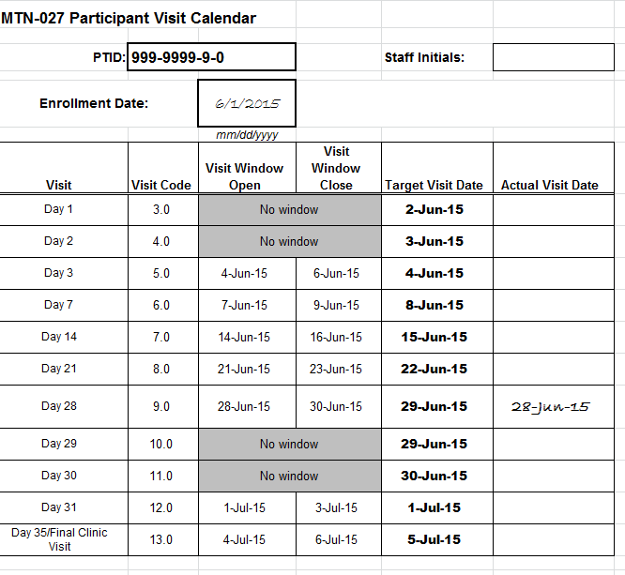
Visit Calendar Tool – Output
Notes:
FOR SITES: Do you think participants will want to know their dates for visits 10-13 before they attend their Day 28 visit? To potentially complete this tool initially with the target Day 28 entered, and then update only if needed (so that participants get a full calendar to start)?

Slide 28
Scheduling Follow-up Visits
Schedule fixed based on randomization date
  does not change based on actual visit completion date before Day 28
Target day is ideal
Note that some visits have visits windows around the target day to allow for the participant to come in a day or two after the target day.
  *Note that Days 1, 2, 29, and 3o do not have visit windows.
  These study visits must be completed on the target day of
  The visit.
  It is ideal to complete Visit 9.0 on Day 28.
  However, it is allowable to conduct this visit between days 27-29 if the participant cannot come to the clinic on day 28.

Slide 29
Missed Visits
A follow-up visit is missed once allowable window closes if she has not completed any part of visit
**Note that if the participant does not complete visit 9.0 within the allowable window, that visit is considered missed and, per the visit schedule, her Day 29 (visit code 10.0) is missed as well.
If a visit does not have a window and the participant cannot come in on her target day, the visit is considered missed.
E.g., participant completes Enrollment and Day 1, but is not able to come back into the clinic until Day 3.
The Day 2 visit has no visit window, thus is missed

Slide 30
Missed Visits
If a participant misses Visit 9 (Day 28), the next time the participant presents to the site the following procedures should be conducted:
  Collection/Removal of IVR
  CBC with differential and platelets
  Chemistries (Creatinine, AST, ALT)
  Pregnancy Testing
  Urine Dipstick
If a participant misses Visit 9, she should contacted and counseled to remove the ring and return to the clinic as soon as possible
Outside of what is listed above for Visit 9 (Day 28), no other visit types or procedures will be made up

Slide 31
Missed Visits
Missed visits are documented in the study database using the Missed Visit CRF
Do not complete or fax any other CRFs for the missed visit
  Protocol Deviation Log not completed/required
The Missed Visit form will let DataFax/SCHARP know not to expect any other forms for that participant with that visit code.

Slide 32
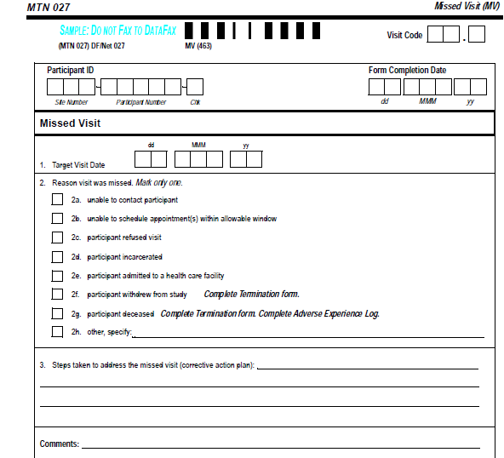
Missed Visits Form
Visit Code is hard-coded with “.0” at end
Target date is per ppt calendar
item 3 = corrective action plan

Slide 33
Interim Visits:
What are they and why are they done?
Visits that take place between scheduled visits
There are a number of reasons why interim visits may take place, can you provide some examples?
Are there any procedures that, per protocol, are required at interim visits?
All interim contacts (e.g., phone calls and/or clinic visits) will be properly documented in study files and on applicable CRFs
Notes:
Reasons:
Report/follow-up on AEs
Counseling
Issues with study product
Required procedures: Procedures required during an interim visit will depend on the reason for the visit.

Slide 34
Interim Visit Documentation
Interim visits documented using the Follow-up Visit Summary CRF (FVS-1)
Interim visit code on FVS-1 let’s SCHARP know visit is interim, along with “yes” to item 6
Need sites to document reason for interim visit and CRFs completed for it (FVS-1 items 6a and 6b)
Notes:
Interim visits should be documented in the database if at least one CRF is newly completed during that study visit.

Slide 35
Interim Visit Codes
If the interim contact results in at least one newly-completed DataFax CRF, the interim visit is assigned an interim visit code
Interim visit codes use the box to the right of the decimal point – assign starting with .1
For the numbers to the left of the decimal point, use the visit code of the most recently-required visit, even if the interim visit date is in the next visit’s window
  The interim visit code will be a number in-between the two visit codes when the interim visit occurred
Ex.: A ppt has an interim visit 4 days after her Day 14 visit to follow-up on an AE; assign interim visit code = 7.1 (in between Visits 7.0 and 8.0)

Slide 36
Split Visits
A visit is a split visit when the required visit procedures are split (done) over 2 or more days
The days must all fall within applicable visit window; any required procedures not done within allowable window are missed
For split visits, only 1 FVS CRF is completed, and the Visit Date on this CRF is the date of the first part of the split visit
  All CRFs completed for the split visit are assigned the same visit code (e.g., CRFs completed for a split Day 3 visit completed across Days 3 and 4 would all have 5.0 as the visit code)

Slide 37

Follow-up Visits – Key CRFs
Follow-up Visit Summary
Follow-up CASI Tracking
Ring Adherence
Social Impact Log
Protocol Deviations Log
Termination
Pregnancy Report and History
Pregnancy Outcome
Participant Transfer and Receipt
Notes:
Clinical and lab CRFs will be review later this afternoon.

Slide 38
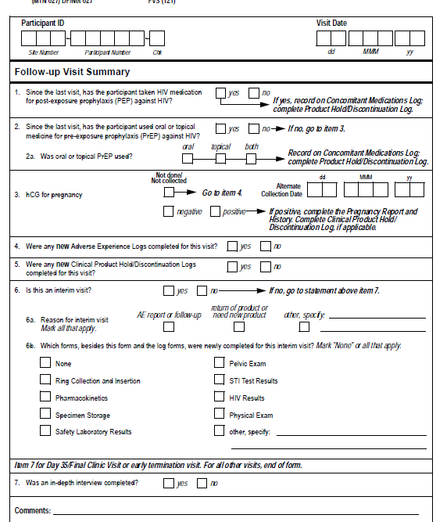
Follow-up Visit Summary CRF

Slide 39
Follow-up Visit Summary CRF (FVS)
Completed each time a required follow-up visit is completed
Prompts for participant use of PEP or PrEP since last visit
Documents pregnancy testing at each required visit
Item 6 asks if the visit is an interim visit, and if so, which CRFs were newly-completed for the interim visit
For required visits, asks if any new AE Log pages or Clinical Product Hold/Discontinuation Log pages were completed
Item 7 required at Day 35 to document completed of IDI

Slide 40
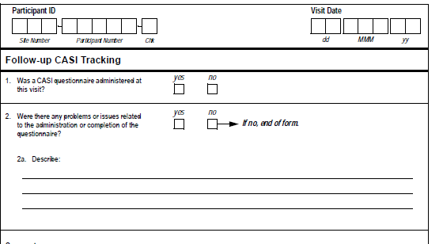
Follow-up CASI Tracking CRF (FCT)
Required on Days 7, 14, 21, 28 and 35/Final Clinic Visit
Complete at any early termination visits
Documents any issues in completing questionnaires

Slide 41
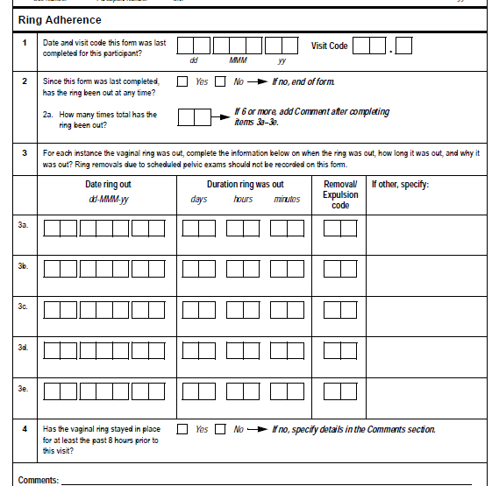
Ring Adherence CRF
Required at each follow-up visit up through day 28
Documents ring outages since the last time that the form was completed
For each outage, indicate date that the ring was out, time of outage and reason for removal
Ring removals due to scheduled pelvic exams should not be recorded on this form (These outages will be reported on the Pelvic Exam Ring Assessment)
Item 4: Note whether the ring has stayed in place for at least the past 8 hours prior to the visit. If no, specify details in the Comments section

Slide 42
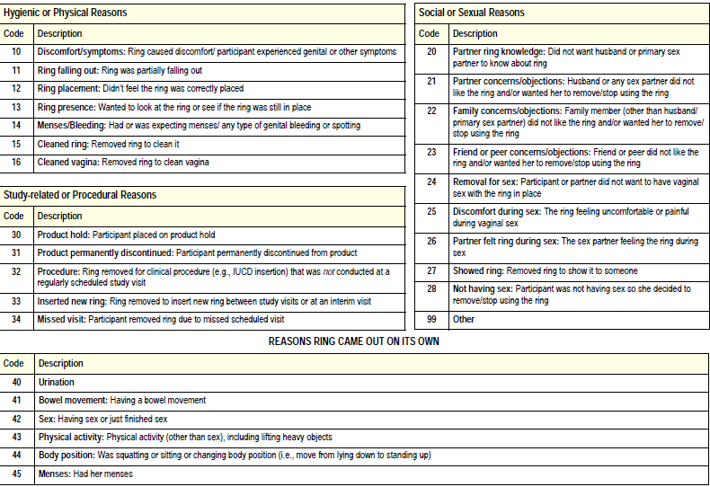
Ring Adherence CRF
Removal/expulsion codes are available in the form instructions
Mark ‘99’ for other if none of the reasons provided apply and specify the reason on the front of the CRF

Slide 43
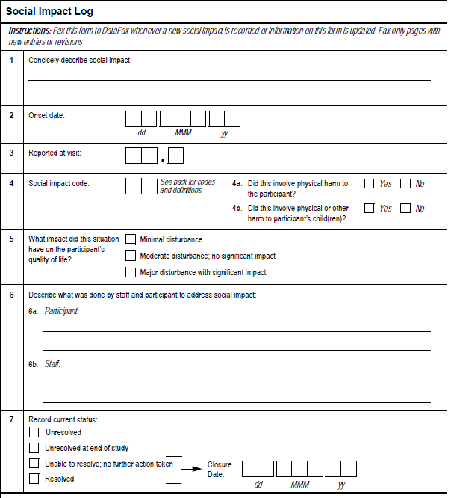

Social Impact Log CRF
Social Impact Codes
Reporting of Physical Harm

Slide 44
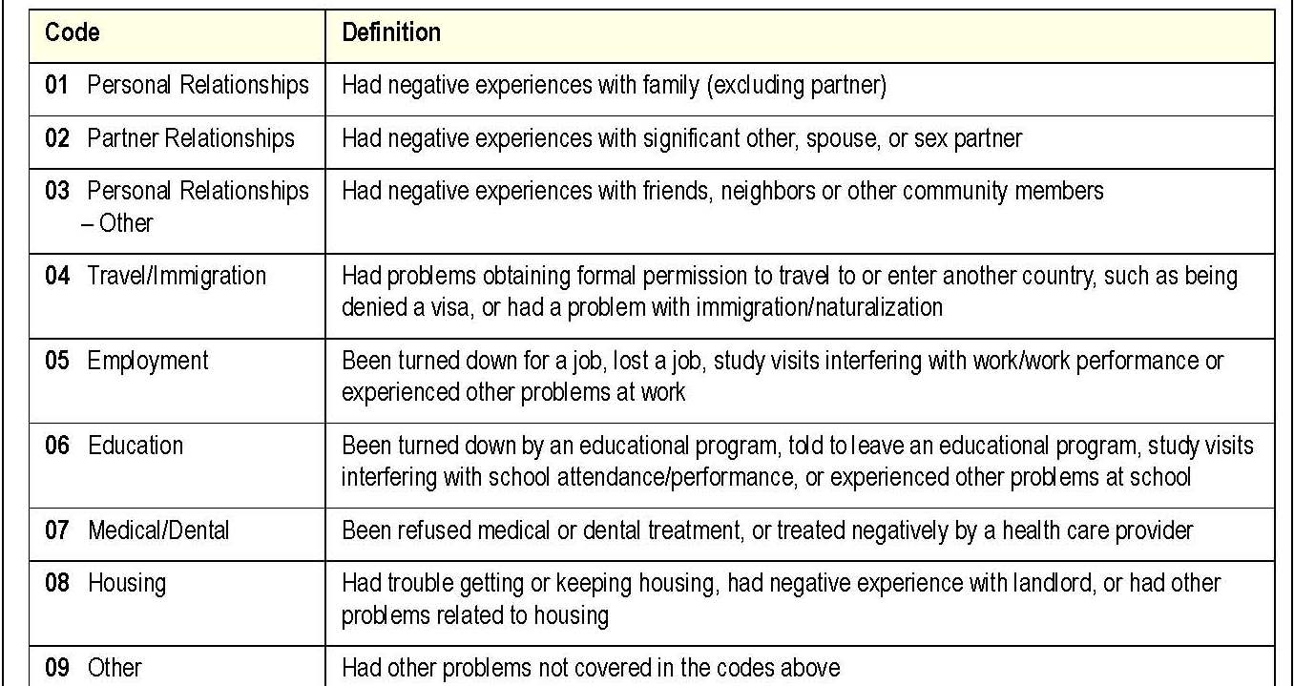
Social Impact Log CRF
Social Impact Codes
Notes:
A list of social impact codes are included on the back of the Social Impact Log CRF for your reference.

Slide 45
Social Impact Log CRF
Item 4: Reporting of Physical Harm
0 1
If yes, consider whether the harm meets criteria for AE reporting.
Notes:
In this scenario, code ’01’, indicating that the participant had a negative experience with a family member, would be marked for the social impact code in Item 4. Item 4a would be marked ‘yes’ and 4b would be marked ‘no’. The site should assess the physical harm to determine if it should be reported as an AE on the AE-1 log CRF.

Slide 46
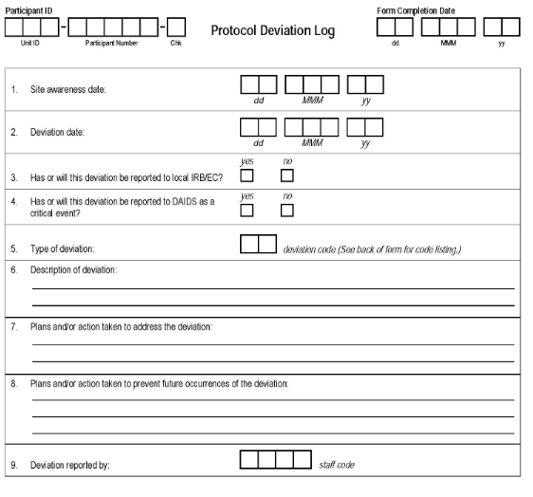
Protocol Deviations Log (PDL)
Fax once PD identified
Complete one form per PTID and deviation type (code)
Notes:
format

Slide 47
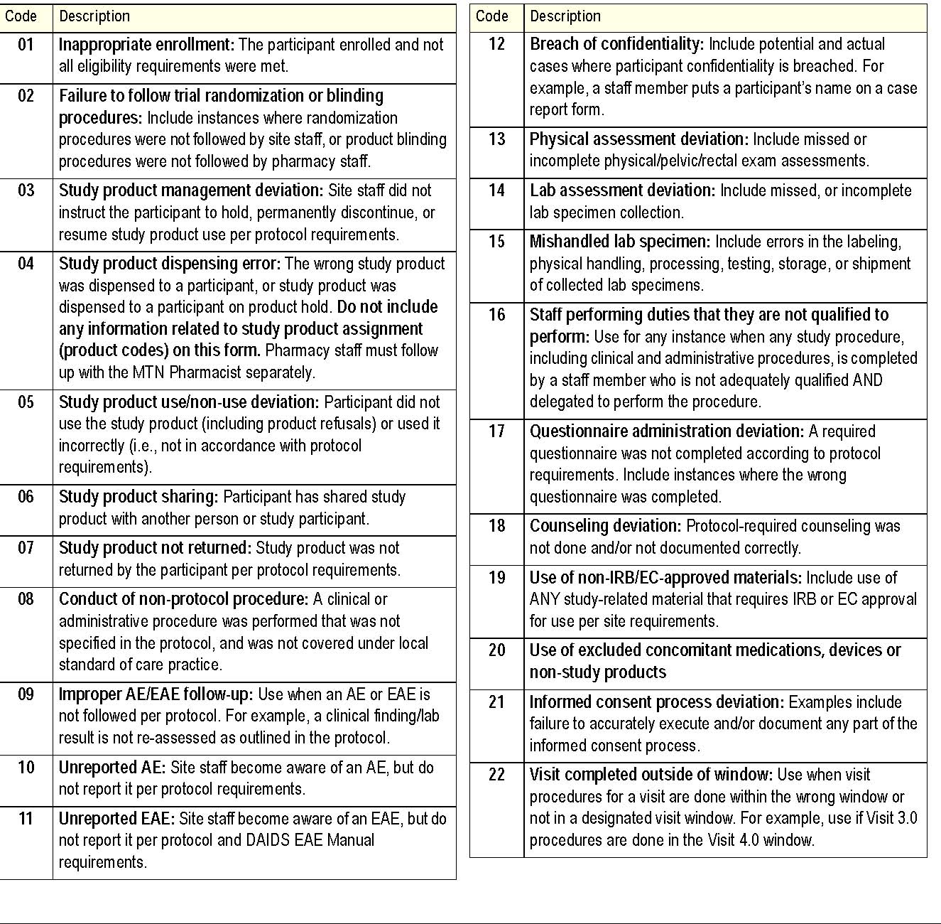
Codes for type of deviation on back of form

Slide 48
Other CRFs
Termination CRF
  Completed at Day 35 visit or in the event of early termination
Pregnancy Report and History/Pregnancy Outcome
  These forms should be completed in the event that a pregnancy is reported in MTN-027.
Participant Transfer & Participant Receipt CRFs
  Unlikely that a participant will transfer between sites, but forms are available in such an event
Notes:
TM is a very standard form that both sites have used extensively in the past, so I didn’t think we needed to go over it here. I just listed out the PR and transfer CRFs to note that we have them should we need them, but rare that it would be used. It’s not worth it to spend valuable training time on forms that will probably never been completed.

Slide 49
Case Report Form Supply
CRFs will not be shipped from SCHARP; sites are responsible for CRF supply
  Print from pdf files located on Atlas
CRFs are available in visit packets and as a single PDF form set
Test fax required to ensure proper printer and fax calibration
Notes:
Recommend: 100g/m2 paper weight (90g/m2 seems to be an ok weight as well)

Slide 50


